Slide 1
Facilitator Guide
Concept Workshop
Version 1.0
Last modified by Mike Burns 2022-05-11

Slide 2
Contents
Facilitators Guide to Running a Concept Workshop
Overview
Process
Outputs
Supporting Tools & Techniques

Slide 3
Overview

Slide 4
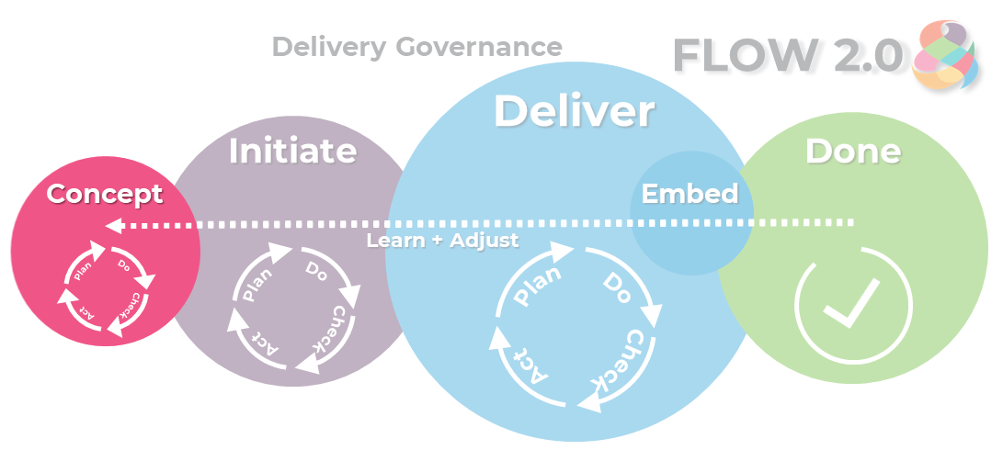
Overview
To discover and identify the work, the context in which the work lives, and identify the stakeholders
Define what success looks like including identifying the inputs and deliverables
Create options with cost/benefit analysis, understand time/cost/scope/quality wishes (sliders), and consider total cost of ownership/cradle to grave lifecycle of the work
Make decisions based on shared understanding of high level scope & architecture, and how we plan to approach the work (engagement model)
Make a ‘go/no go’ decision

Slide 5
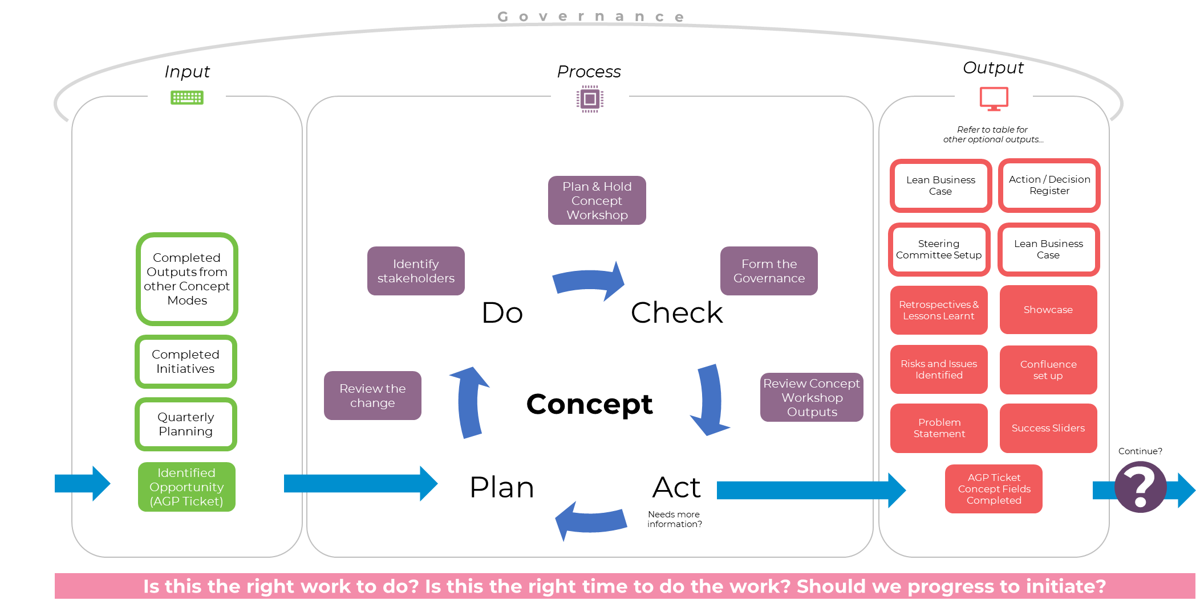

Slide 6
Consider the Context
Legal requirements & implications
Finance (opex/capex, budgeting, financial management & reporting)
Marketing (dependencies, timelines)
Training & development
Communications (internal & external)
Human resources (strategic & tactical)
Facilities (work environments & usage, target environments & usage)
Transport, storage & inventory management
Business strategy alignment
Architectural strategy alignment
Deployment strategy
Migration strategy
Disaster recovery
Productionisation / globalisation
End product management (product management, ownership, reporting)
Reporting & analytics (data warehouse/BI)
Support & maintenance (handover/transition)
Delivery of solution (project management)
Team distribution (local/global)
Third-party engagement, integration, transitions
Regulation, compliance, standard adherence
Hardware, software, documentation requirements

Slide 7
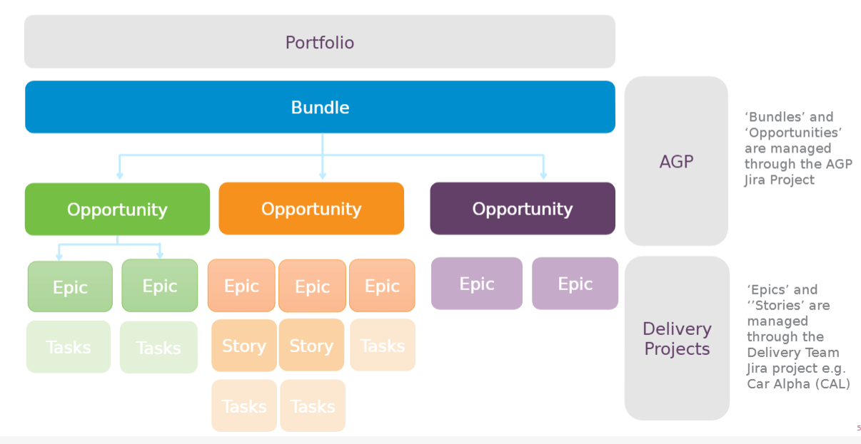
Idea Maturity
This work breakdown happens during Concept phase
Ensure that you have the right people in the room
Choose the right tools – you wont need all of them, usually one from each will be sufficient but a larger or complex project may require more tools to pull the right information at the right time

Slide 8
Process
Delivery team/s will be engaged more in the detail of the change, and will elaborate and break up work into right-sized chunks.

Slide 9
Approach
Team based collaboration session.
Toolset and approach (using an appropriate capture mechanism) which is reflected in the technical stack and environment configuration.
Focus on progress over perfection.
Iterative, evolving knowledge growth.
Frequent feedback loops.
Constant decision making.

Slide 10
Activities
Understand the background, problem or opportunity to be addressed by the work
Understand success criteria (time, costs, scope, quality, compliance) wishes (sliders)
Consider risks
Scope of work (not requirements) based on internal and external customers of the solution
Identify needs per customer, stakeholders, architecture, technical stack, lifecycle options and acceptance criteria of the work
Focus on strategic alignment
Cost-benefit analysis is the analysis of the cost-effectiveness of different alternatives in order to see whether the benefits outweigh the costs.
Invention – possible ways to implement the solution
Consideration of new development, reuse, repurposing
Consideration of engagement models – in-house / outsourced / COTS
Understanding of MMF, MVP, and long-term versus short term goals
High level features, requirements, non-functional attributes
High level design, architecture
Cost/benefit analysis
Draft delivery plan - in alignment with other current or future delivery work
Communications plan
Deployment plan

Slide 11
Who is involved?
Portfolio management team
Product Manager
Project Manager
Skill Set Representatives
Regulators
Audit/Compliance
Internal BU
Organisational Change Manager (OCM)
Configuration Item Manager (CIM)

Slide 12
Questions
What problem are we solving?
What are we not solving?
What is definitely included?
What is definitely not included?
How does this align to our strategy?
What is acceptable?
Do we have all the right people involved?
Where does the value flow from/to?
What is the order of things?
What options do we have?
What do we already have that might solve this? Or almost solve it?
Do we have to do this work? Or can we buy it or outsource it?
What is the minimum that we need to do? Now? Later?
What are the non-functional attributes of the solution?
What are the features?
What is the architecture?
Is this worth doing?
How will we deliver it?
Who needs to know about it?

Slide 13
Approval To Proceed
It is important to go back to the owner of the work, to ensure that the size of the work, and the planned approach, are acceptable.
The sponsor will agree that the team should move into the Initiate phase and invest time in building this solution, or may park or cancel the initiative.

Slide 14
Outputs

Slide 15
Deliverables
Project Charter/Canvas (context, RAIDS, cost / benefit analysis, lifecycle choice)
Success criteria (dates/scope/costs)
High level definition of done
High level technical design
High level test strategy
Scope matrix
Stakeholder matrix
Risk matrix
Regulatory engagement model
Infrastructure delivery indicative timelines
Support and maintenance handover requirements
Alignment with other Business Unit release timetables

Slide 16
Supporting Tools and Techniques
Examples of tools and techniques to support you during the Initiate workshop, and throughout Initiate phase.

Slide 17
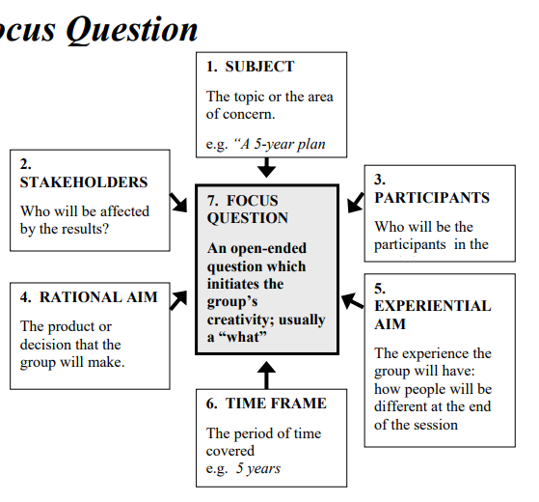
Tools – Focusing Question
The focus question should:
be an open-ended question
draw out many specific responses from each person
name the subject as specifically as possible
identify the stakeholders (at least as “we”)
identify the time frame (if relevant)
be simple and clear enough for the participants to answer with a minimum of explanation
“What’s the ONE Thing I can do such that by doing it everything else will be easier or unnecessary?”
http://www.greenschemesnc.com/files/122316822.pdf

Slide 18
Tools - Value Sliders
Project Success Sliders are a way for key project stakeholders or a product owner to convey their expectations to the team.
Project success sliders were first described in the book Radical Project Management by Rob Thomsett.
Sliders | Description
 | Feature completeness (scope)
 | Stay within budget (budget)
 | Deliver Epic on time (time)
 | High quality, low defects (quality)
ON
OFF
ON
OFF
ON
OFF
ON
OFF
https://www.mountaingoatsoftware.com/tools/project-success-sliders

Slide 19
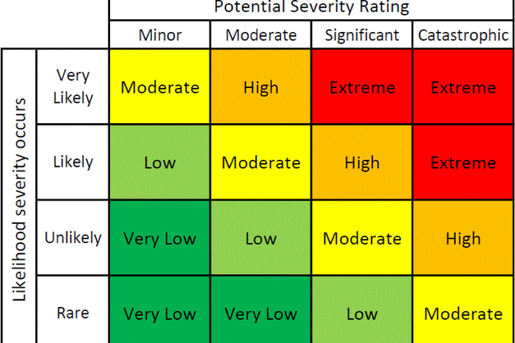
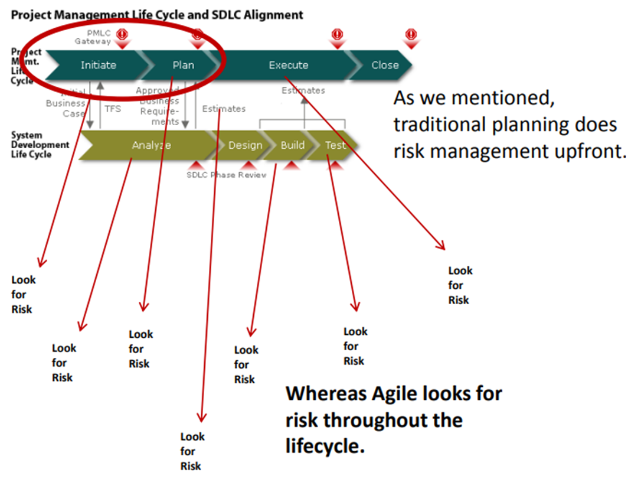
Tools - Risk Matrix
Transparency – Expose everything we are doing so we can see risks early
Collaborative planning – Harness the knowledge of the entire team and see more risks
Customer involvement – Mitigate customer risk by involving them throughout the lifecycle
https://www.agilealliance.org/wp-content/uploads/2016/01/Agile-Risk-Management-Agile-2012.pdf

Slide 20
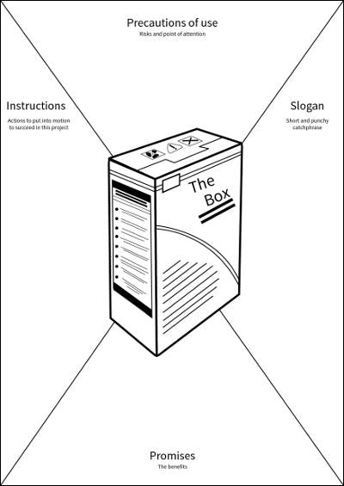
Tools - Product Vision Box
It is usually used to launch new projects, to help facilitate any vision-oriented discussion and to determined a new product’s range.
Teams are asked to imagine that this product will be sold in a *department store**, just like another everyday product. As they imagine the product, they make decisions about its name, a slogan, a logo and 3 or 4 key selling points on the front of the packaging. And on the back of the packaging: a detailed description, the prerequisites and the conditions of use.
https://stormz.me/en/blog/stormz-games-product-box1

Slide 21
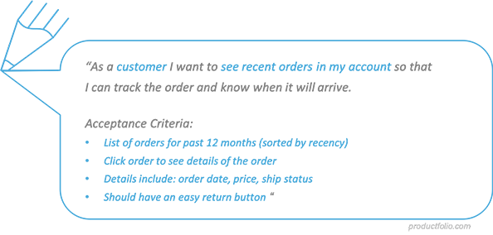
Tools – Acceptance Criteria
Bullet points to show what is acceptable
Not what makes it done.
Think of an exam – it is done, but may not be right (or acceptable) that only happens during checking answers (or testing)
https://productfolio.com/what-are-acceptance-criteria/

Slide 22
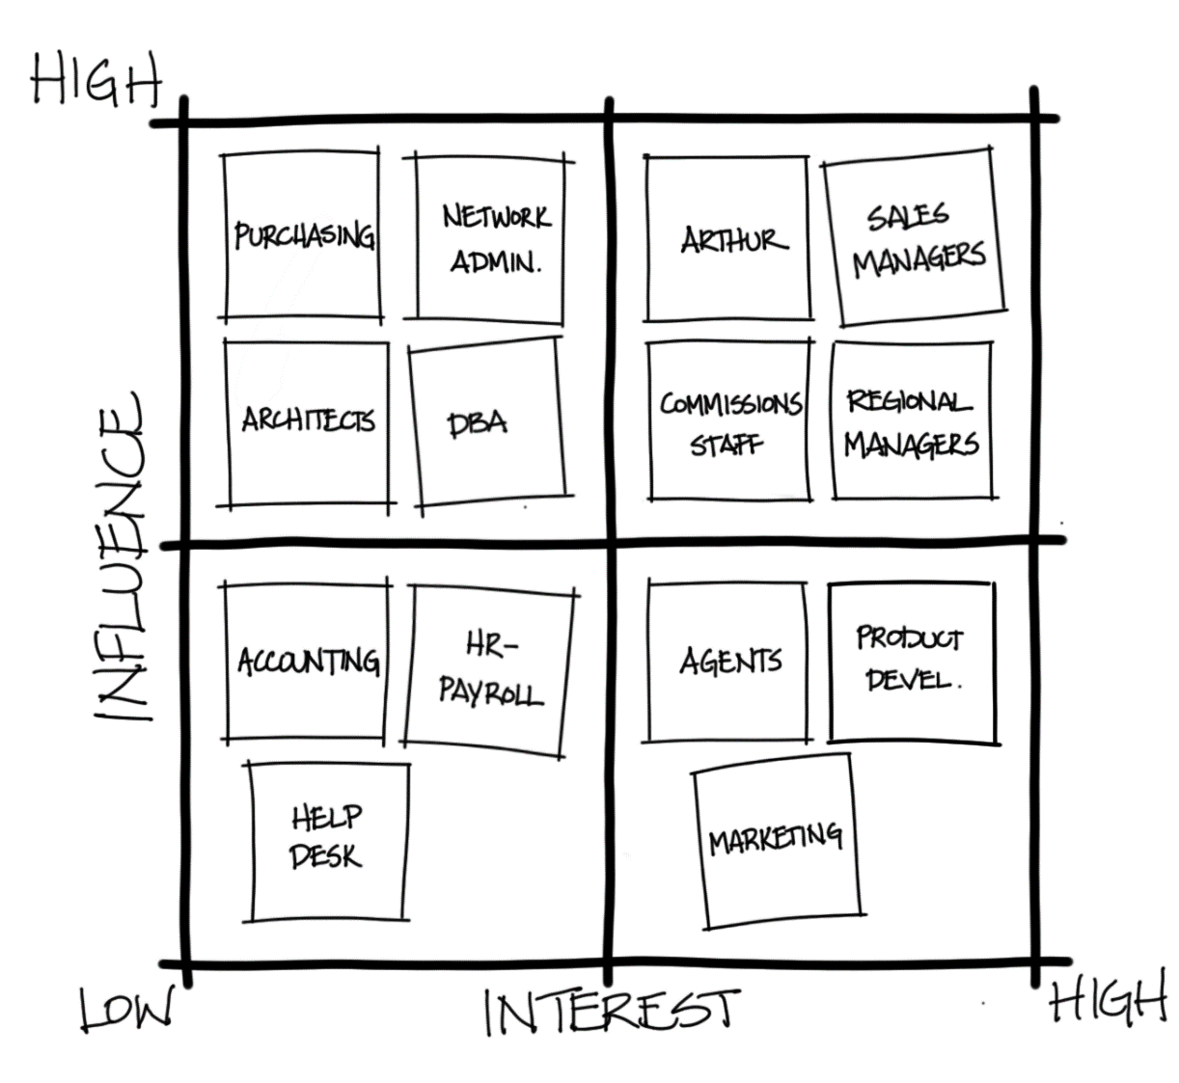
Tools - Stakeholder Matrix
By mapping out the stakeholders we achieve the following:
Know who everyone is and can see if there are any missed people
Think about what they want to achieve by solving this problem and how much they can help us through their influence and interest
Think about how we will engage with each of the stakeholders
Group stakeholders together to improve efficiency

Slide 23
Tools - Roles & Responsibilities
Role | Name and Position Title | Responsibilities
Note: A RACI is often too much detail that goes unused.
Try RA instead. Who is responsible, who is accountable. Then consult and inform everyone via the showcase.

Slide 24
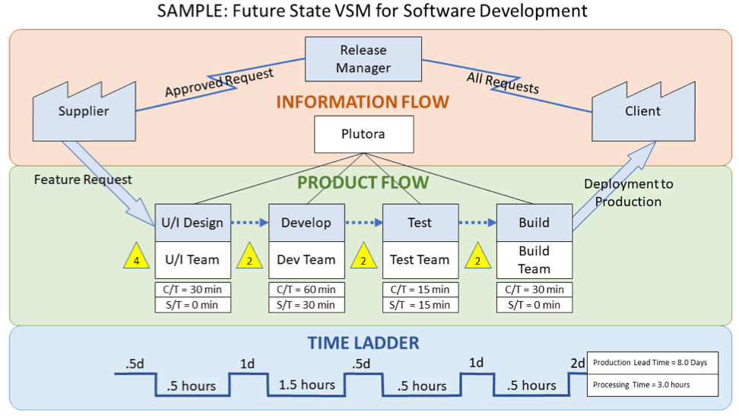
Tools - Value Stream Mapping
A value stream map shows all the processes involved from a customer request to fulfilling the request.
It can show where process inefficiencies are by analysing the time it takes to complete a step in the process and how much waiting time there is between steps.
https://www.plutora.com/blog/value-stream-mapping

Slide 25
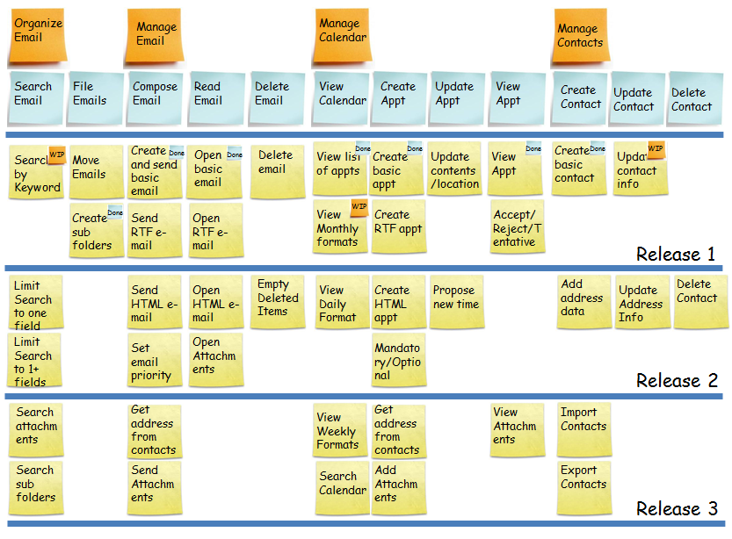
Tools - Story Maps / Backbones
During Concept phase you wont have all the stories yet, but you can still start the top section of the story map.

Slide 26
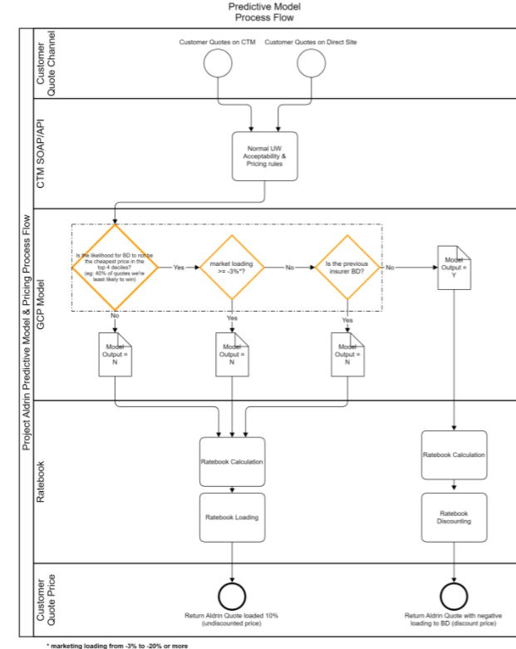
Tools – Business Process Modelling
BPM is a standardise way of looking at a process flow.
It doesn’t need to be a formal BPM – but swim-lanes, a start and end point, and some decisions along the way can make a problem much easier to understand.

Slide 27
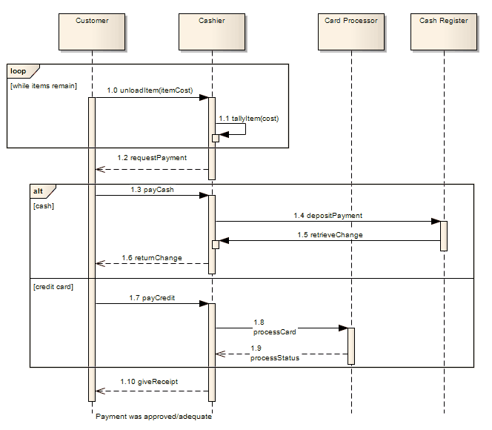
Tools – Sequence Diagrams
A sequence diagram is a diagram that allows for actions, data flows, and other messages to be visualised between different actors and systems.
It can show loops and alternative routes based on different conditions.
The can be formalised using tools (https://www.websequencediagrams.com/ is a great tool), but can be just as powerful if drawn on a whiteboard - the key is to collaborate with the team. Getting more people involved will help transfer knowledge about solution decisions and you’ll get a better outcome.

Slide 28
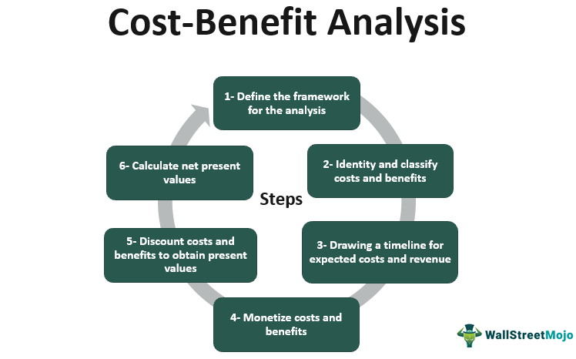
Tools - Evaluate Cost / Benefit
What are the effects on users?
What are the effects on nonusers?
Are there any externality effects?
Is there a social benefit? Employee benefit?
https://www.wallstreetmojo.com/cost-benefit-analysis/

Slide 29
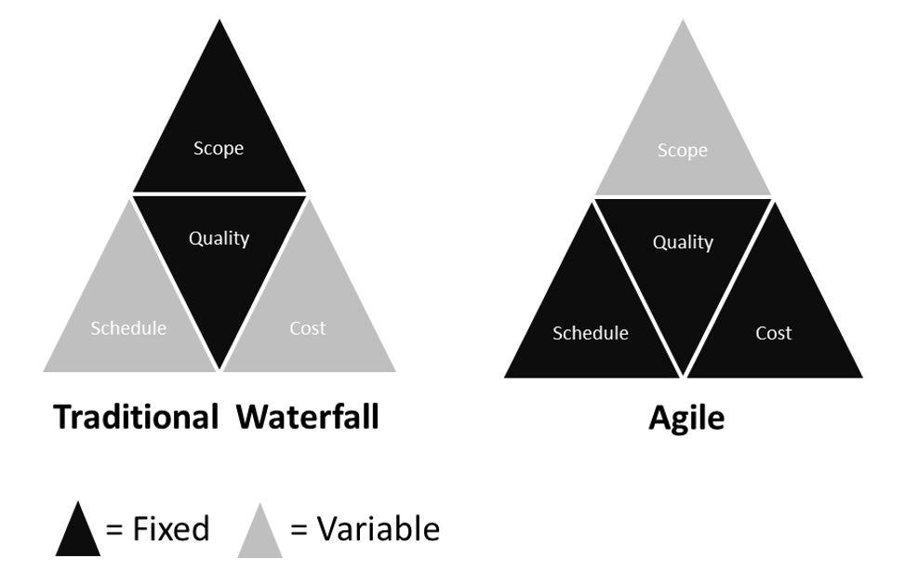
Tools – Iron Triangle
If Scope is variable Then
Quality levels can be defined
Cost can be defined (by staff x days x $ + expenses)
Schedule can be set – release dates can be defined upfront and always met (it will be the scope that adjusts)
The concept of the Iron Triangle is based on 3 variables and one dependent one. The three independent variables are Scope, Time, and Cost. The dependent variable is Quality. The formula is:
Quality = f (Scope, Time, Cost)
Scope is about the volume of work assigned.
Time is about the duration available to do it.
Cost refers to the number of resources you want to devote to the task.
Quality is about the resultant quality of the output.

Slide 30
Tools - MMF
Minimal Marketable Feature are the smallest set of functionality that must be realised in order for the customer to perceive value.
A feature is a group of stories that are related and deliver a package of functionality that end users would generally expect to get all at once
A really big story that needs breaking down
Features
Epics
Story
Story
Story
Task
Low level work team needs to do in order to deliver the story

Slide 31
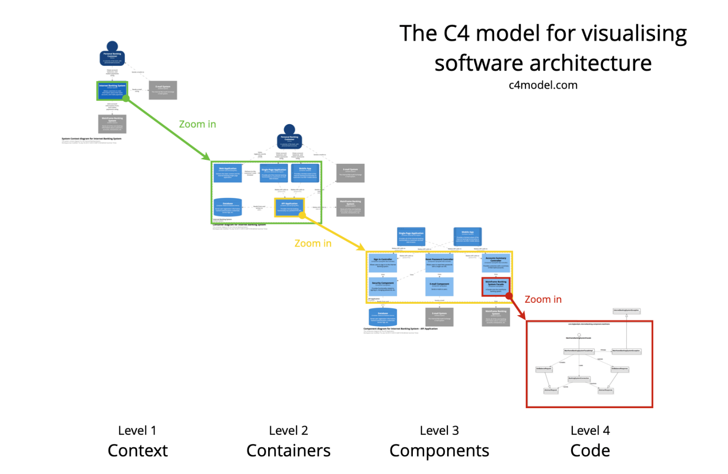
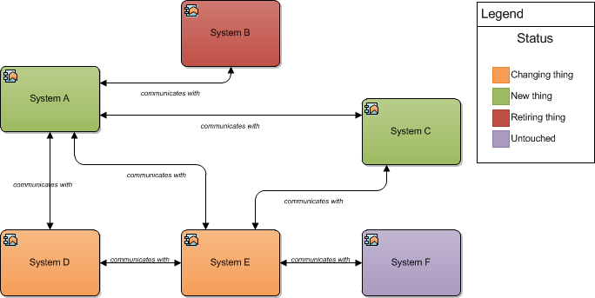
Tools – Architecture Diagrams
Solution architects will work with Product Managers/Pos and other key stakeholders to complete solution options.
Solution options will include high level solution overview models, costs and benefit/risk profile.
The recommended solution is then utilised to guide the identification of the features to be delivered. Features may be delivered internally through team or through the assistance of partners and vendors.

Slide 32
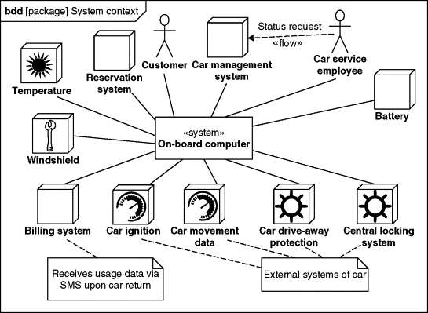
Tools - Context Diagrams
Track the interactions of customers/personas and the solution
System Context Diagrams represent all external entities that may interact with a system… Such a diagram pictures the system at the centre, with no details of its interior structure, surrounded by all its interacting systems, environments and activities. The objective of the system context diagram is to focus attention on external factors and events that should be considered in developing a complete set of systems requirements and constraints.
https://www.sciencedirect.com/topics/computer-science/context-diagram
https://www.ba-guru.com/system-context-diagram-example/

Slide 33
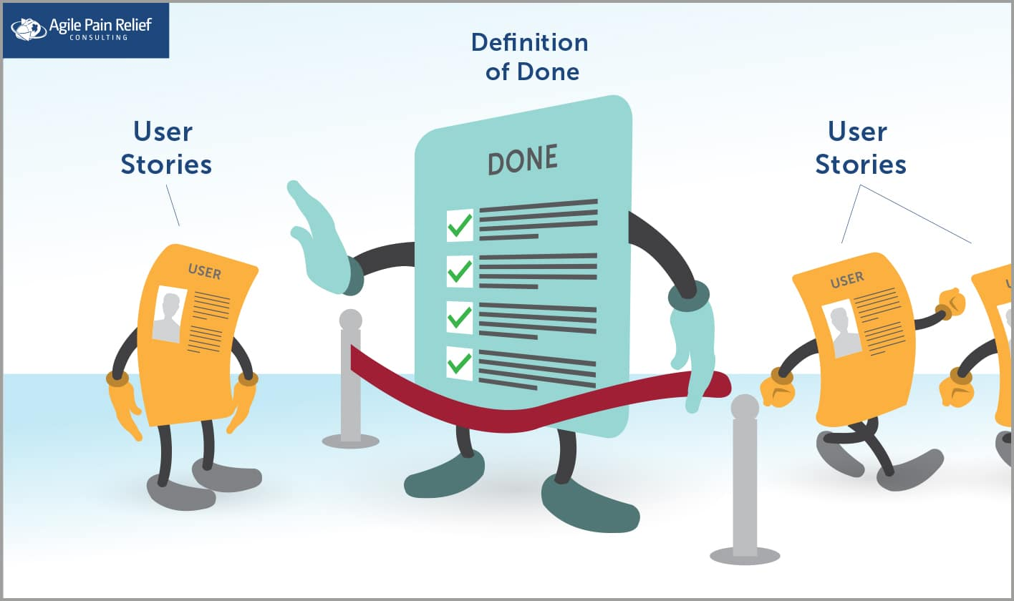
Tools - Definition of Done
Identify all the things that need to be addressed for the solution/project to be considered done
https://agilepainrelief.com/blog/definition-of-done-user-stories-acceptance-criteria.html

Slide 34
Name – AGP-XXX
Opportunity Sponsor: Name, Role
Product Owner: Name, Role
Delivery Lead: Name
Delivery Team: Name
5W2H
1. Who is the customer?
What is the problem that needs to be solved?
Why is it a problem? (highlight the pain)
Where is the problem observed? (location, products)
Who is impacted (Customers, businesses, departments)
When was the problem first observed?
How is the problem observed? (symptoms)
How often is the problem observed? (error rate, magnitude, trend)
External customer?
Internal Customer?
Problem Statement
Root Cause
2. Needs a way to (Jobs to be done)
to do something.
Def 1: def def def
Def 2: def def def.
Definitions
3. Surprisingly/because/but
Surprisingly……

Slide 35
Name – AGP-XXX
Opportunity Sponsor: Name, Role
Product Owner: Name, Role
Delivery Lead: Name
Delivery Team: Name
Objectives
In Scope
Out of Scope
Establish…
Create…
In scope items
Out of scope items
Objectives & Scope
Undecided
List the scope items that are yet to be determined in or out of scope
Undecided

Slide 36
Name – AGP-XXX
Opportunity Sponsor: Name, Role
Product Owner: Name, Role
Delivery Lead: Name
Delivery Team: Name
Key Milestones
Measures of Success – we will be successful when:
Delivery commences XX/XX
Achieve some outcome
Targets
Risks and Issues
There is a risk that <event that has an effect on objectives>.
Inter Dependencies
Related Initiative/s | Nature of Dependency | Timing
RAIDS
Assumptions
We believe <this assumption> to be true based on <these reasons>.

